Slide 1
BBEACONS
Thomas Van Raemdonck & Wouter Vande Velde
Notes:
wouter

Slide 2
Table of contents
What?
Mobile Application
Website
Database
Trilateration
Notes:
wouter

Slide 3
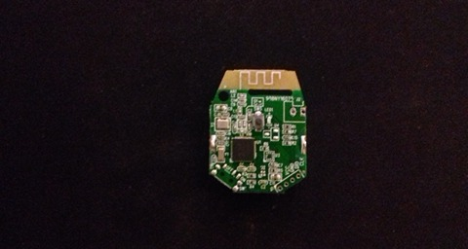
What?
Indoor location
Bluetooth beacons
Website
Database
Mobile Application
Notes:
Thomas

Slide 4
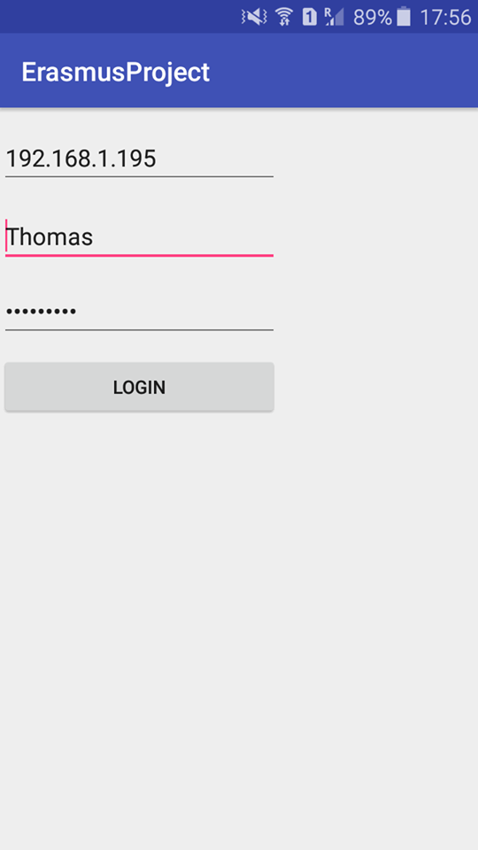
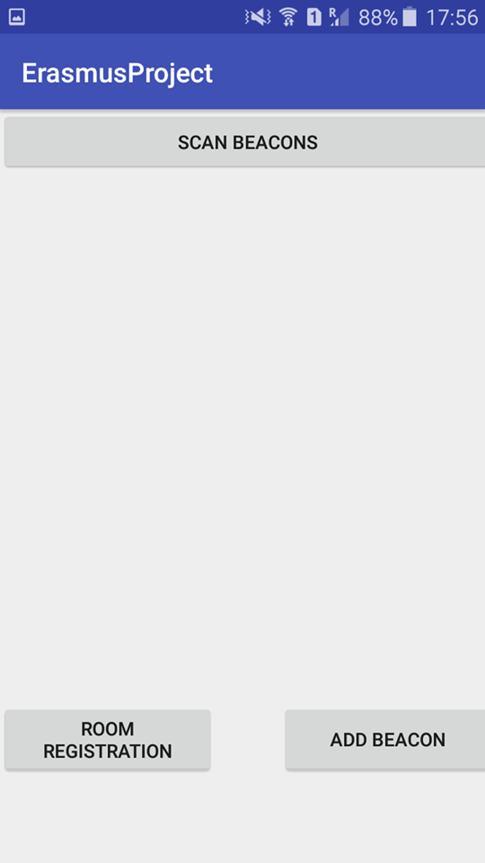
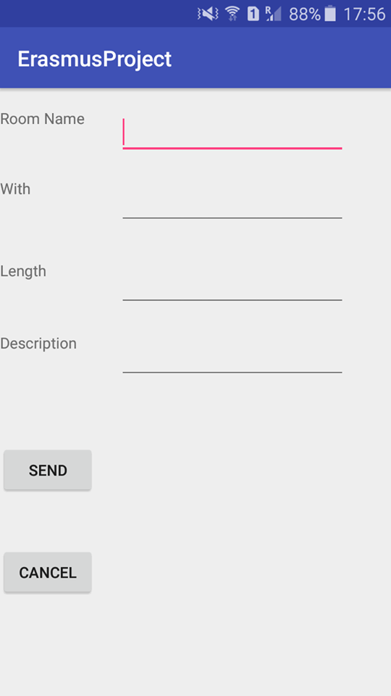
Mobile Application
Android Studio
Login
Add beacon
Add room
Scanning beacons
Heatmap
Notes:
Thomas

Slide 5
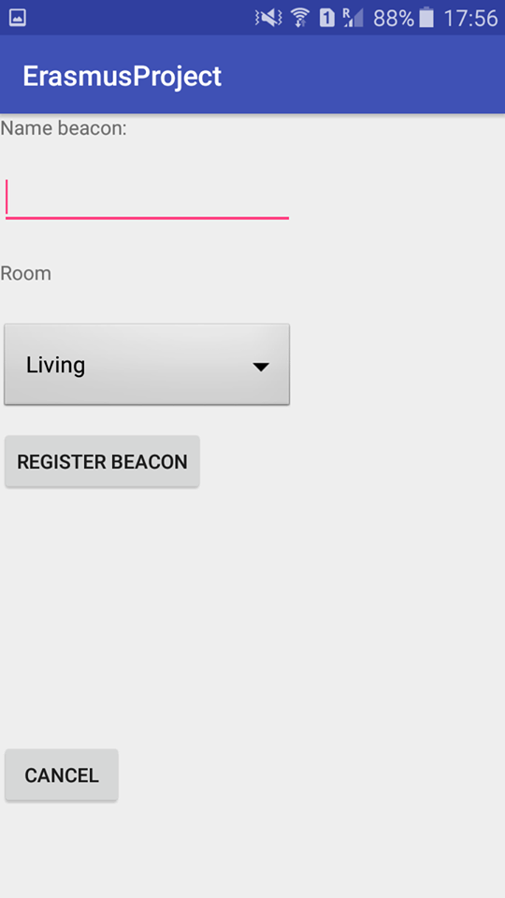
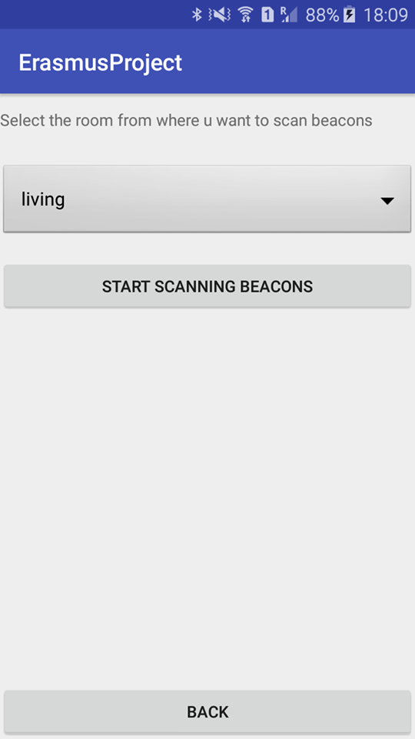
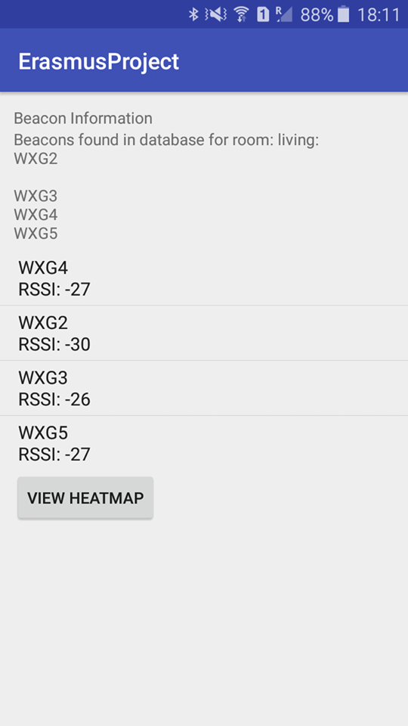
Mobile Application
Notes:
thomas

Slide 6
Website
Shows raw data
Rooms
Localhost
Wamp
Notes:
wouter

Slide 7
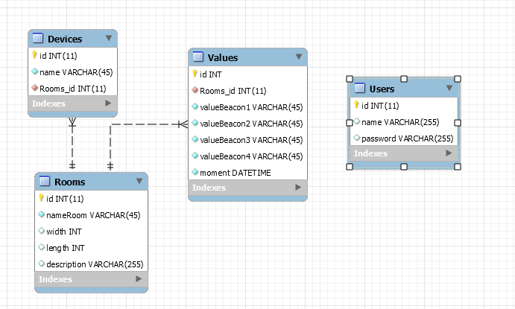
Database
Mysql
Local server
phpmyadmin
User table -> connection
Notes:
thomas

Slide 8
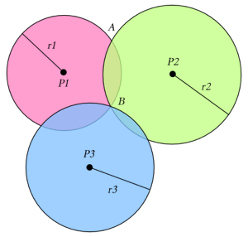
Indoor location
How?
Trilateration
3 Beacons in a room
Distance from the 3 beacons
Notes:
thomas

Slide 9
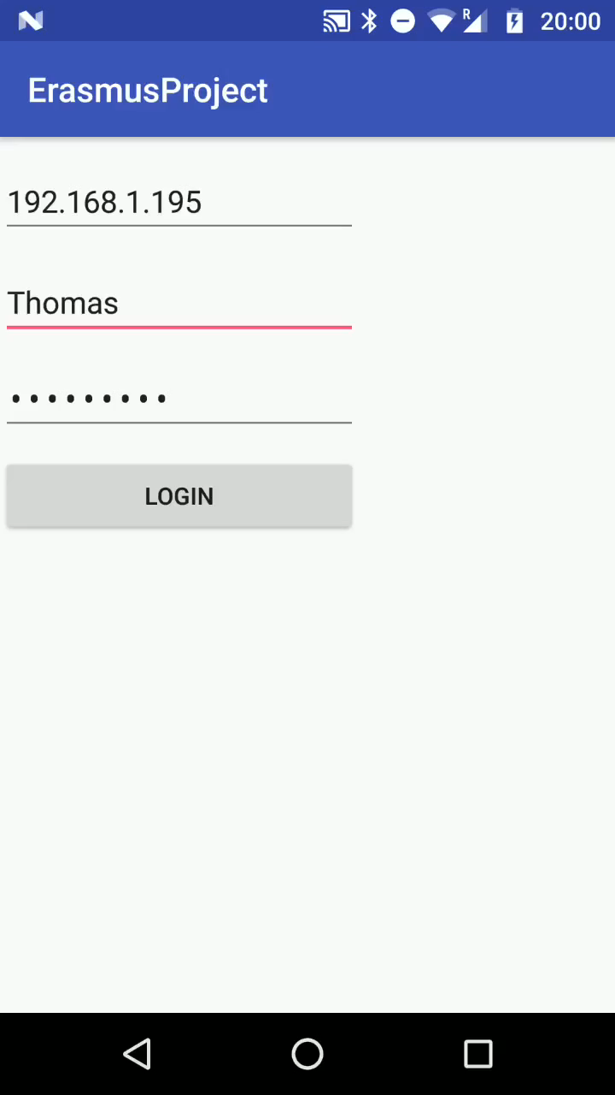
Demo
Notes:
thomas

Slide 10
The end
Questions?
Notes:
wouter

